Slide 1
Food Recognition System Using a Classification Model

Slide 2
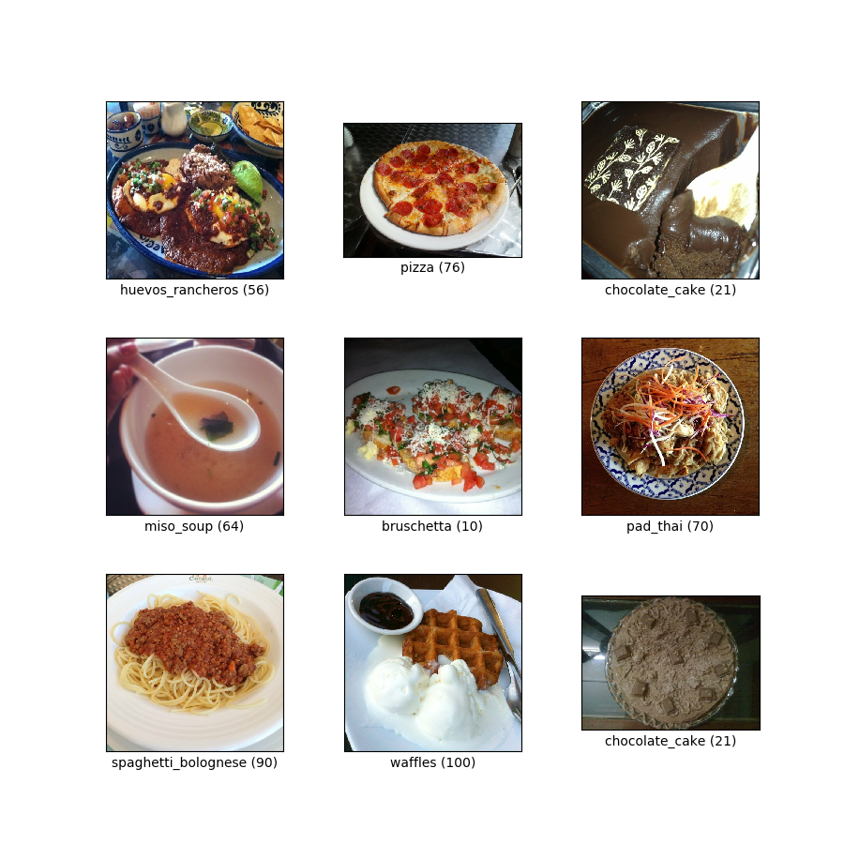
Dataset
Train
Test
Validation
Food 101

Slide 3


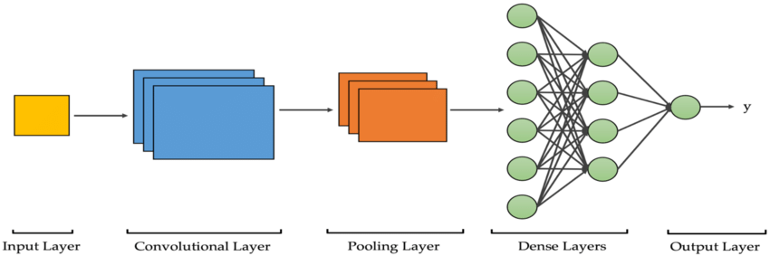
Why this topic?
Explore TensorFlow library.
Discover CNN and Computer Vision techniques.
Improve our data preprocessing skills.
Learn how to build better classification models using neural networks.

Slide 4
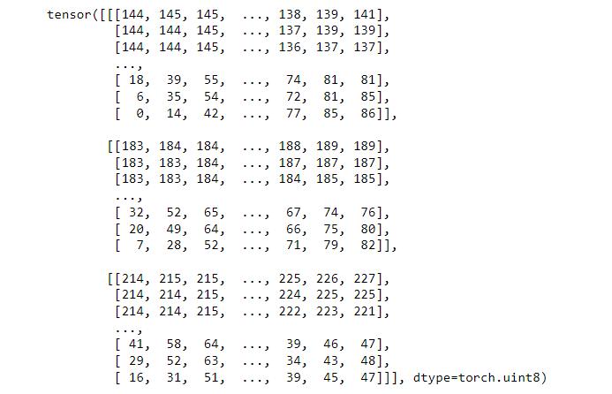
How does data look like in TensorFlow?
Images are converted into tensors.
Shape = (512, 512, 3)
Advantages compared to numpy arrays:
Are backed by the accelerator memory, GPU.
Many built-in functionalities to implement Deep-Learning.

Slide 5
General steps
1
Visualize and inspect the data.
2
Prepare and preprocess dataset.
3
Build CNN classification model.
4
5
6
7
Fit the model.
Evaluate the model.
Improve the model through experimentation.
Save the model.

Slide 6
Thank you for your attention.

